Slide 1

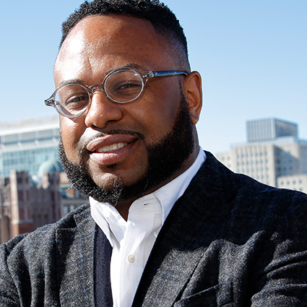






ARTIFICIAL INTELLIGENCE & INCLUSION:
FORMERLY GANG-INVOLVED YOUTH AS DOMAIN EXPERTS FOR ANALYZING UNSTRUCTURED TWITTER DATA
William R. Frey^{[1]}
Desmond U. Patton^{[1]}
Michael B. Gaskell ^{[1]}
Kyle A. McGregor ^{[2]}
SICSS 2019 – Princeton University
^{[1]} Columbia University
^{[2]} NYU Langone Health
@williamrfrey
w.frey@columbia.edu | williamrfrey.com
Notes:
My name is William Frey and I am a doctoral student in the SAFElab at Columbia University’s school of social work.
In the SAFElab, we have an overarching aim for our work:
How do we support youth of color living in neighborhoods with high rates of violence to be their authentic selves online?
This involves two main focuses:
Looking at the intersections of social media and violence, while using mixed methods in gun and community violence prevention.
It also involves ethical considerations around the current surveillance and monitoring techniques used by law enforcement to criminalize Black and Brown youth online.
Today, I am here to talk about one of the strategies we are using to do this work with these main focuses in mind:
Hiring formerly gang-involved youth as domain experts in the interpretation and analysis of social media data.

Slide 2





Gangs increasingly challenge rivals online with postings, videos
The Desire to Live-Stream Violence:
Why would four suspects in Chicago broadcast the torture of a man on Facebook Live?
London Murder Mystery: Why Killings Are Up:
[London police chief citing role of social media in homicides]
Gang rape. Suicides. Shooting deaths. The dark side of social media
Chinese social media ’spreading violence and obscenity’
Notes:
If we are seriously considering how to substantially prevent and intervene in gun and community violence, we cannot ignore social media as a multidimensional domain influencing it.

Slide 3
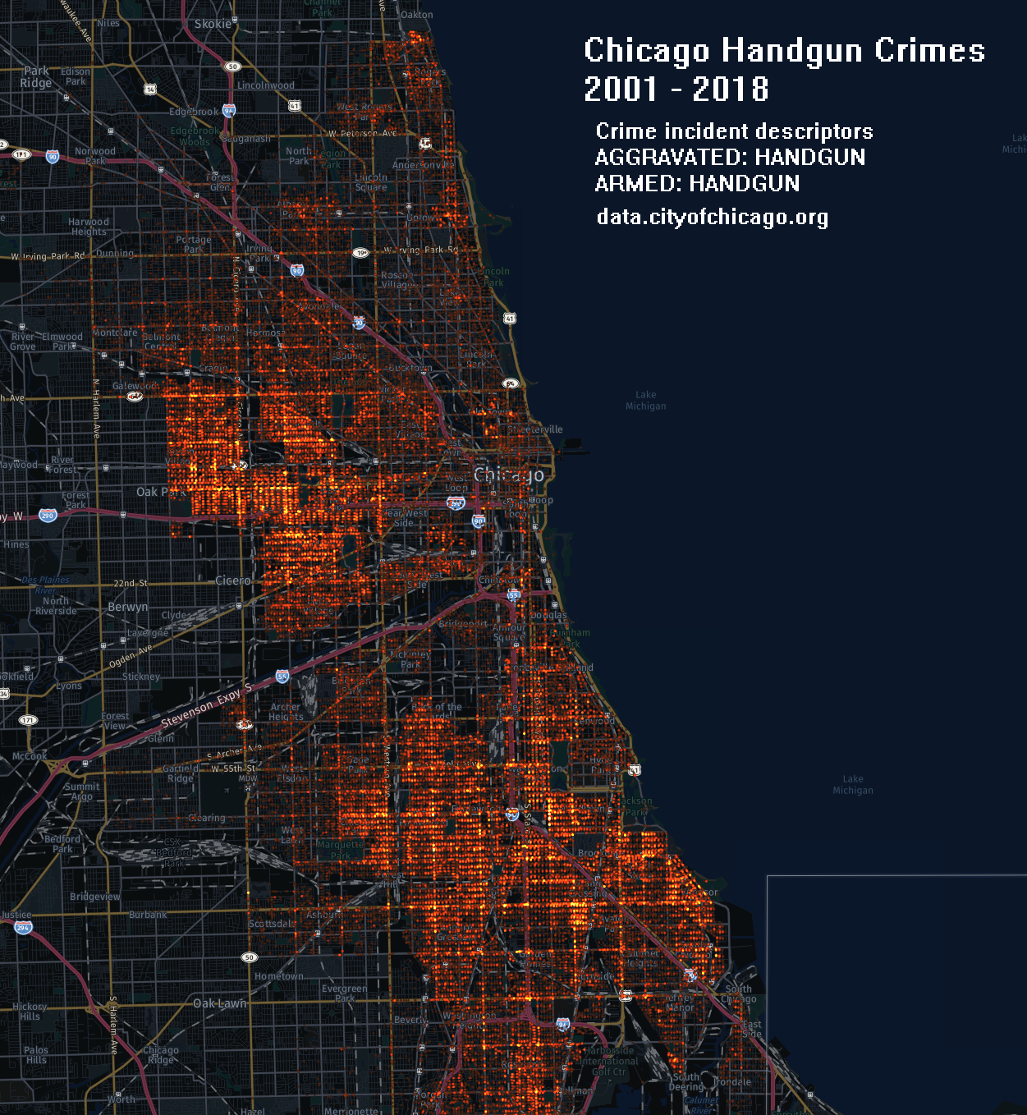
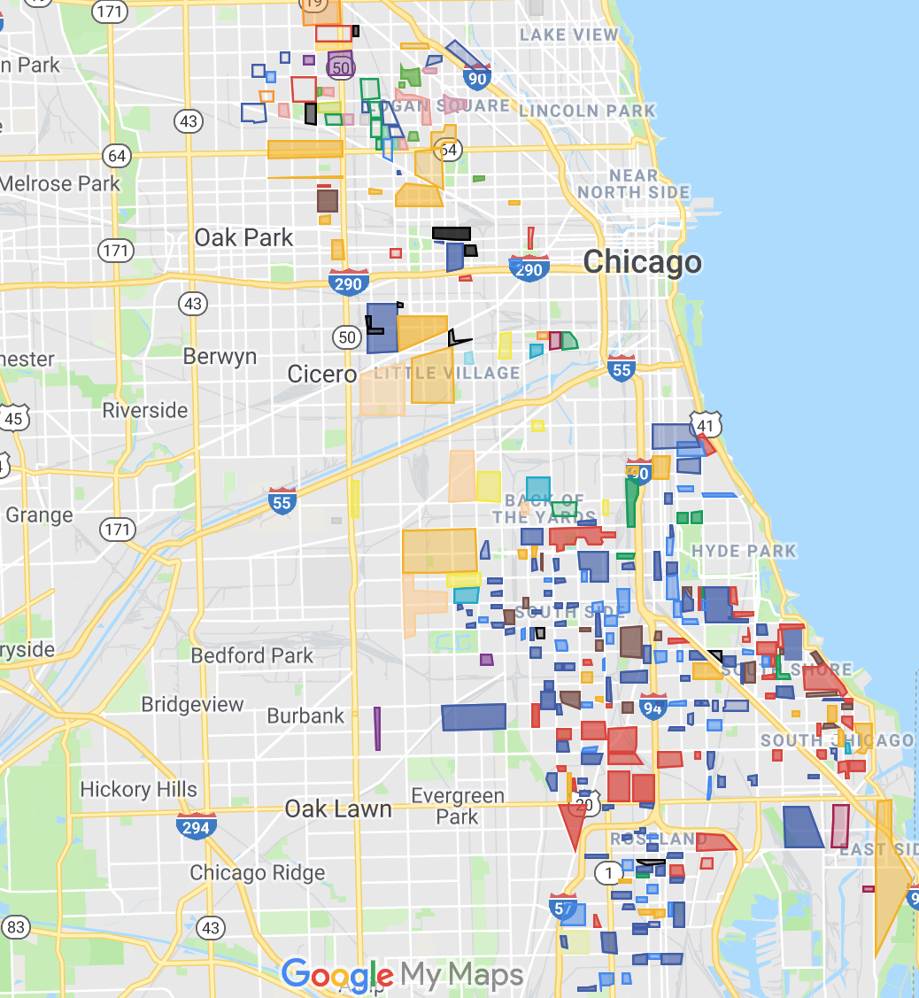
Notes:
This is especially true for Chicago, where we focused our research for this study.
Violence remains a public health issue in Chicago. In 2018, 418 people were murdered with 1,843 shooting victims.
While these numbers have gone down over the last couple of years, they remain significantly high.
Most murders involved guns, occurred in public places, and stemmed from what police believe was some sort of altercation.
On the right you see a map that represents the shifting territories of people who are gang and crew involved in Chicago. While this map represents the offline territories, young people often have an online presence as well.

Slide 4
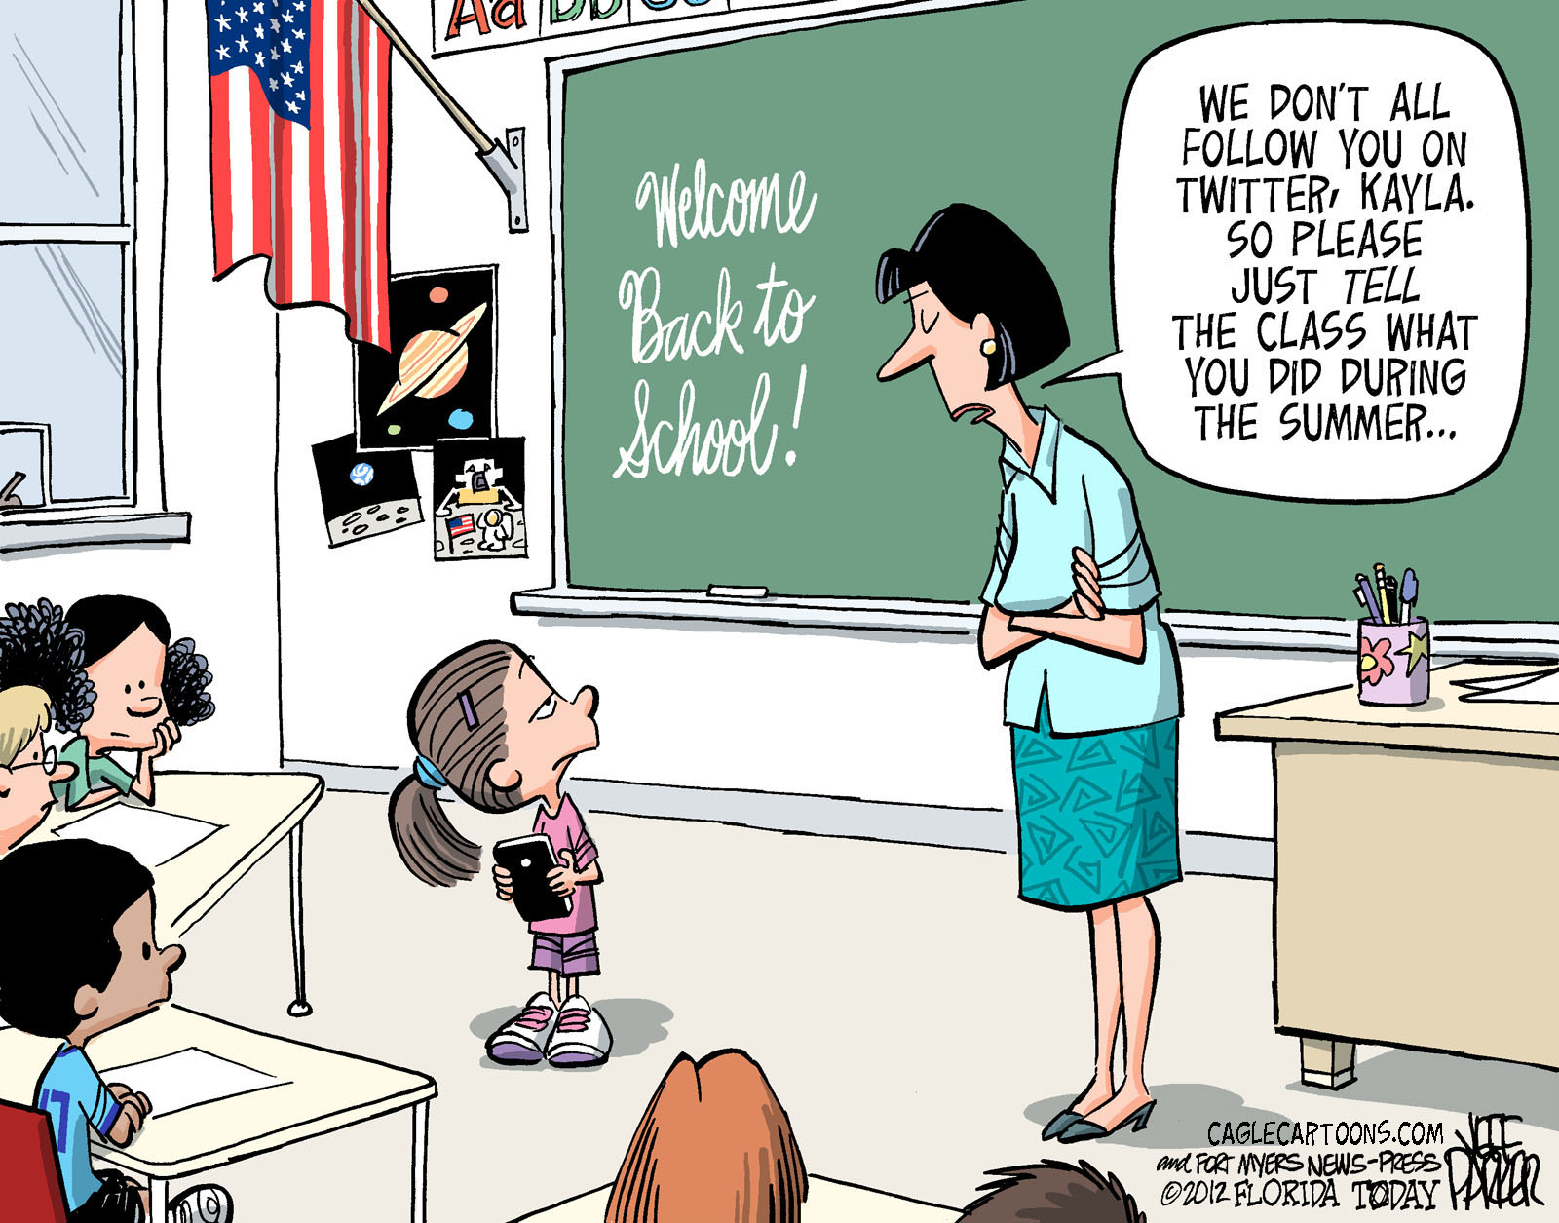
SOCIAL MEDIA DATA
Notes:
So now that I have told you about the problem we are seeking to address, I want to explore with you the benefits and challenges of using social media data in our work.
Access to Big data have changed the way we can conceptualize research, intervention, and prevention in social work, especially for understanding and supporting people who are difficult to reach, and affected by violence.
Given the ever-growing popularity of the Internet, smartphones, and social media, people who are hard-to-reach generate data that are able to be collected and analyzed.
However, utilizing Big Data requires more than simply collecting large amounts of it. The data must be acquired, stored, and annotated before any meaningful findings can be applied for intervention and prevention work.

Slide 5







UNSTRUCTURED DATA
“Human Information”
Khan, N., et al. (2014). Big data: Survey, technologies, opportunities, and challenges. The Scientific World Journal, 2014, 1–18.
Notes:
Further complicating our online prevention and intervention work is that most of the data generated by humans is considered unstructured.
Things like videos, photos, and social media posts.
Unstructured data provide a nuanced and rich reflection of the human experience.
Unfortunately, this richness and nuance that make unstructured data so appealing also make them difficult to study empirically.
Because of the BIG in big data, computational methods are often used for filtering and classifying this data. Most of which require some degree of initial training or feedback based on human-generated knowledge.

Slide 6



CLASSIFICATION
Is this a cat? [Yes/No]
Notes:
Manual classification of data may be easy for simple tasks.
For example, Is this a cat? Yes or No.

Slide 7

CLASSIFICATION
Is this a credible threat?
Notes:
However, what about for complex societal or human behavior issues? like suicidality, hate speech, or threats?
Making classifications such as these are subjective and are fraught with potential for bias and misinterpretation.

Slide 8
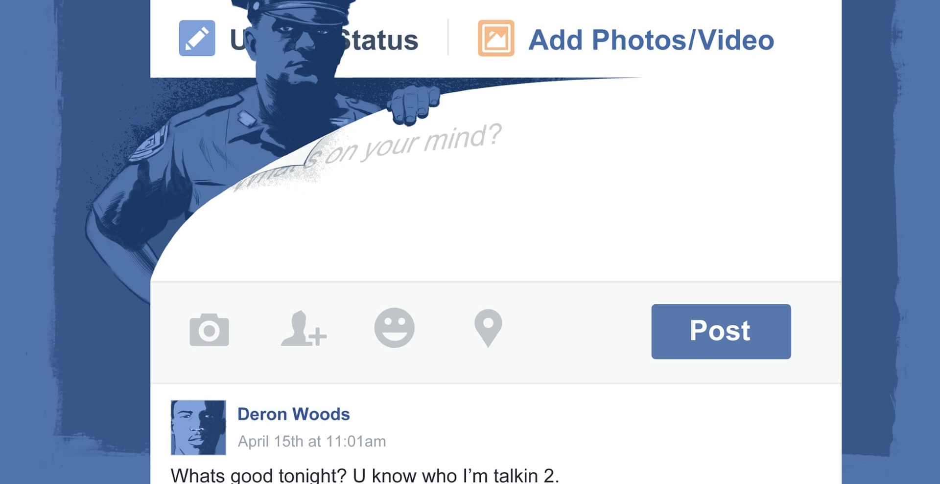
Notes:
Undeterred by the challenges posed by classification of digital threats, police departments are monitoring and surveilling social media, making decisions about interpretation and meaning, often serving their purposes of indictments and arrests.
Who are involved in conversations around what constitutes criminal behavior online?
Who are being monitored digitally and what factors are considered?
How are complex social media posts interpreted and acted upon?
These questions are especially important in communities where gangs and crews are prevalent, and corresponding cultural behaviors permeate into the lives of people throughout the community. This blurs the identifying features of gang affiliation and involvement, especially on social media.

Slide 9
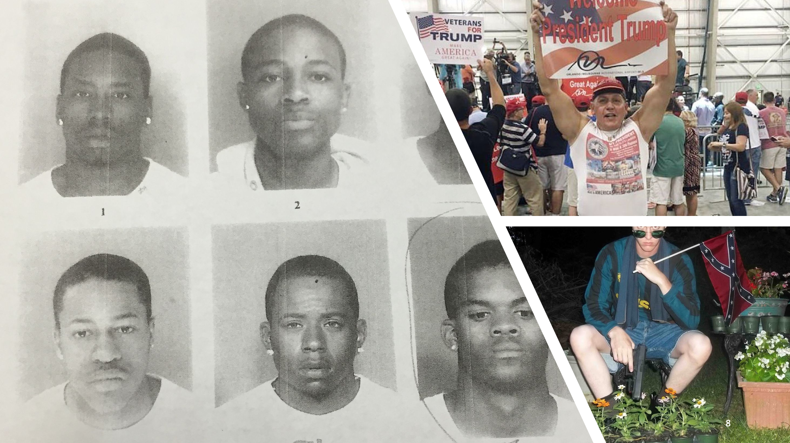
Notes:
Undeterred by the challenges posed by classification of digital threats, police departments are monitoring and surveilling social media, making decisions about interpretation and meaning, often serving their purposes of indictments and arrests.
Who are involved in conversations around what constitutes criminal behavior online?
Who are being monitored digitally and what factors are considered?
How are complex social media posts interpreted and acted upon?
These questions are especially important in communities where gangs and crews are prevalent, and corresponding cultural behaviors permeate into the lives of people throughout the community. This blurs the identifying features of gang affiliation and involvement, especially on social media.

Slide 10
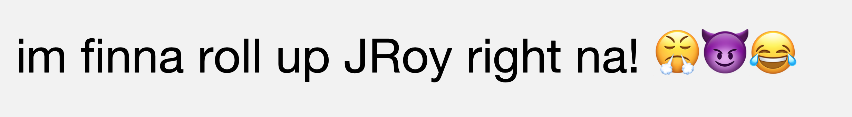

DOMAIN EXPERTS
Notes:
However, for young people living in neighborhoods with high rates of violence, understanding the potential meanings of a post could be a matter of life or death
So if I were to ask a young person to classify these posts from their own community, chances are they would be able to tell me relevant, nuanced interpretations of meaning, language, and the contextual features
They have a specific domain expertise for how to navigate their surroundings, including digital ones.
This is where our work sits.

Slide 11
VISION
Unstructured
Social Media
Data
Improved Accuracy of
Unstructured Data Categorization
Domain Expert
Interpretation
+
=
Violence Interruption
and Prevention
Building of Computational Tools for Community Organizations
Notes:
We argue that giving voice to youth of color with lived experience in gang and crew culture improves the accuracy of unstructured data categorization, decreases bias in our computational systems, and greatly enhances our ability to accomplish our overarching goal of interrupting and preventing violence.

Slide 12
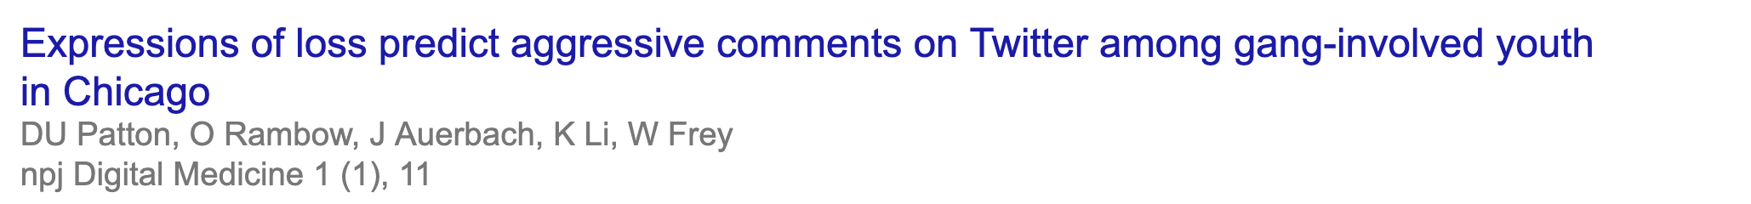

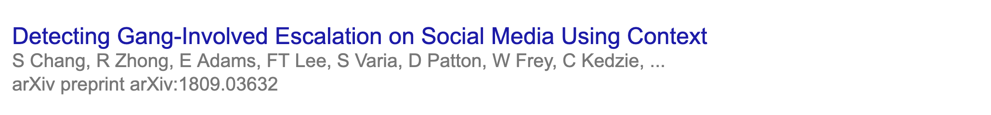



COMPUTATIONAL WORK
2018
2018
2019
Notes:
We argue that giving voice to youth of color with lived experience in gang and crew culture improves the accuracy of unstructured data categorization, decreases bias in our computational systems, and greatly enhances our ability to accomplish our overarching goal of interrupting and preventing violence.

Slide 13

CHICAGO DATA
The Gang Intervention and Computer Science Project
N = 279 Users
Seed User: Gakirah Barnes
Digital Snowball Sampling
Connection, affiliation or engagement with Chicago Crew/Gang
Last 200 tweets from each user
Retroactively starting in February 2017
Notes:
In this study we leveraged the Gang Intervention and Computer Science Project, a partnership between Columbia School of Social Work and the Columbia Data Science Institute.
Gakirah: self-identified as gang-involved, had a large twitter following, and was a shooter in her crew. Allegedly, she had shot up to 17 people by the age of 17. In April 2014 she was shot and killed by a rival gang just hours after posting her address on Twitter.
In order to build a larger corpus of users, we utilized a snowball sampling technique often used to recruit hard-to-reach populations, with Gakirah and her top communicators as our seed users.
Once we had a sample of 279 users using this technique, we scraped their last 200 tweets from Twitter (starting in February 2017).

Slide 14
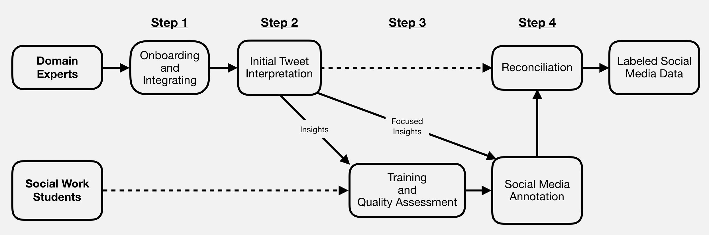
DOMAIN EXPERT INTEGRATION PROCESS
Notes:
Step 1: partnered with a CBO in Chicago; the executive director identified two young people to participate as domain experts based on their willingness, former gang involvement, use of social media, and exposure to violence.
Integration of domain experts and their insights is not as smooth as it may seem. The two young people did not view their knowledge as domain expertise. They had difficulty deciphering what was and was not common knowledge, as they know how to navigate their online and offline surroundings so well. This knowledge is second nature to them.
So this required some training and annotating with them to demonstrate what interpretation of social media data looks like, and the limits of my own knowledge.
Step 2: After we formally hired them through Columbia, we gave them iPads and keyboards and asked them to interpret a random sample of posts from our dataset. This led to key domain expert insights: Language, Emojis, Song Lyrics, Behavioral/Temporal Cues, People, Neighborhood References, Gang/Crew Knowledge
Step 3: All of these insights are then used to train social work masters student annotators to contextually analyze social media posts from Chicago neighborhoods with high rates of violence.
These students also go through a rigorous 1-2 month training process which includes: Chicago as a context, physical locations, gang and crew territories, news articles to build a historical understanding of violence, YouTube videos, and immersion in Twitter accounts of gang-involved youth. They are trained to use web-based resources, like Twitter Advanced Search, Hipwiki, and other sources of domain expertise to triangular meaning and context
They then complete practice annotations and error analysis with the myself, and back up all interpretations with evidence.
Finally Step 4: includes our social work students annotating social media posts in our dataset and receiving more focused insights from domain experts, when they come across very challenging posts to interpret. This is followed by a reconciliation process where we collectively meet to develop a final label for each post in our dataset.
This entire process is used to create the training dataset for building computational tools which can label posts automatically, but we still include an error analysis of the algorithmic output with domain experts to improve our computational tool and interpretations.

Slide 15

REFERENCING OFFLINE CONTEXT
CASE EXAMPLES

Slide 16
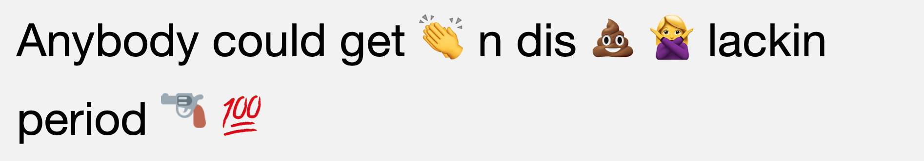
EMOJIS
CASE EXAMPLES
Notes:
As you can see, these types of interpretations require a nuanced understanding of language, syntax, emojis, offline spaces and events,
and leave a great amount of room for misinterpretation.
Again I want to reiterate what we learned from this specific study:
youth of color with lived experience in gang and crew culture improve the accuracy of social media post interpretation and decrease bias in our computational systems.

Slide 17
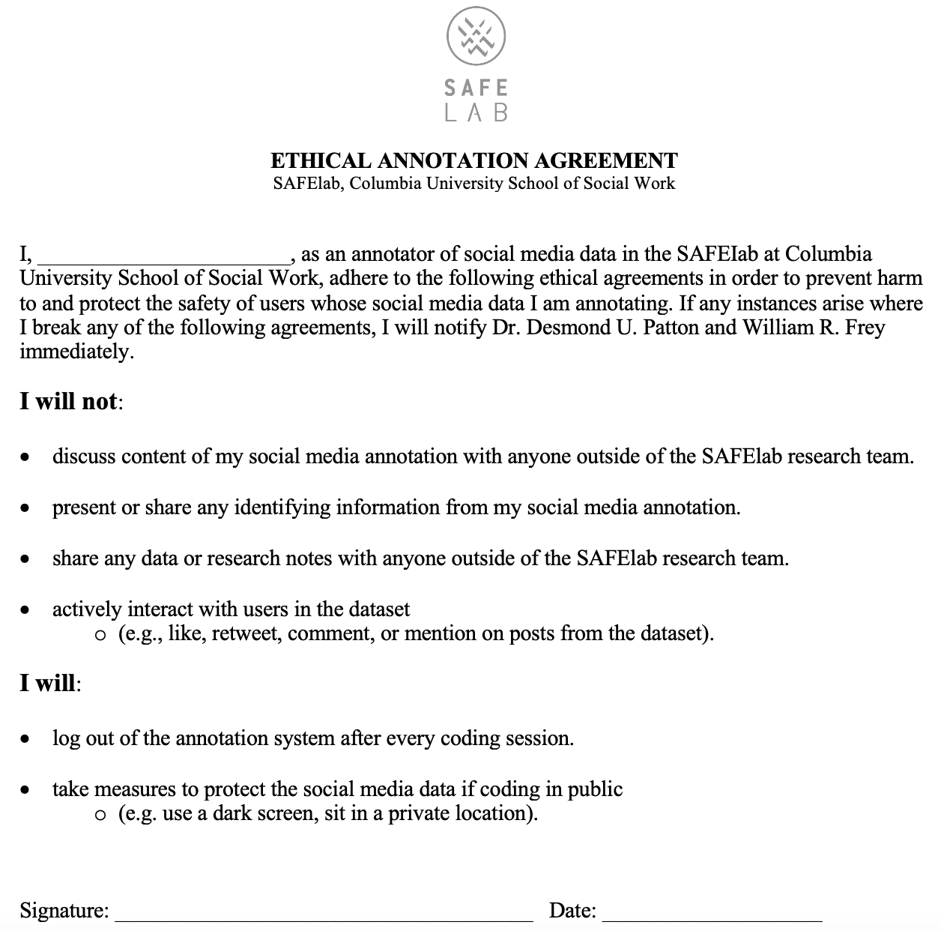
ETHICS
No Law Enforcement Partnerships.
Memorandum of Understandings (MOU)
Sharing: De-identified and Unsearchable posts
Ethical Annotation Agreement
Notes:
Even though these are very important conclusions to come to, our work still has the potential to further harm and marginalize Black and Brown youth, who are already more likely to be surveilled and arrested.
It is because of this that we spend much of our time thinking about ethics, in order to thoughtfully consider the unique space our work fits, in efforts to prevent violence while also not extending and enhancing the punitive surveillance and monitoring of Black and Brown young people.

Slide 18
MOVING FORWARD
Incorporating participatory research frameworks.
Community-Based Participatory Research
(Youth) Participatory Action Research
Community-driven AI development
Fair and Equitable Compensation
See Ghost Work by Gray and Suri
Information Justice
Notes:
Moving forward, we need to consider how to engage in digital prevention work that incorporates participatory research frameworks.
Artificial intelligence systems that impact marginalized communities are being developed with these communities in mind, but without their involvement. Moving forward, we must build equitable relationships with these communities in order to develop community-driven processes and strategies for computational prevention work from the outset.
Second, in a new book by Gray and Suri, Ghost Work, they speak about annotators and data labelers as the new sharecroppers. How do we make sure we fairly and equitably compensate domain experts for their work and involvement?
Finally, in the data driven age, we must consider who does and does not have access to their own data (both personal and community level). How do we make sure marginalized people and communities have access and are able to leverage data about themselves, and how can we, researchers, academics, and computational social scientists do work which leads to information justice.

Slide 19
We would like to express our gratitude to our domain experts, Kevin and Danny, for providing their insights and sharing their experiences. We would also like to thank our community partners, Eddie Bocanegra and Meg Helder for their support and input on this study.
THANK YOU
@williamrfrey
@SAFElab

